Slide 2
Metadata-driven Data Pipelines

Slide 3
What is a Metadata-Driven Data Pipeline?
A metadata-driven pipeline is a dynamic and configurable ETL process that uses metadata (data about data) to control how data moves and transforms.
Instead of hardcoding logic, pipeline behavior is determined by metadata tables/configurations.
Example: If the metadata table says “Load customer.csv → Transform → Store in dim_customer” the pipeline automatically adjusts without code changes.
Why Metadata-Driven Pipelines?
Traditional ETL pipelines are rigid and difficult to modify.
Metadata-driven pipelines make ETL configurable, scalable, and reusable.
Benefits:
Dynamic Configuration – Modify behavior via metadata tables, not scripts.
Reusability – One framework supports multiple sources and targets.
Scalability – Easily onboard new data sources.
Standardization – Enforces consistency across projects.
Faster Development – Less code → quicker deployment cycles.

Slide 4
Key Components of a Metadata-Driven Pipeline
Example – Metadata Table Design
Component | Description | Example
Metadata Repository | Stores configuration & control information | Source details, mappings, load frequency
Metadata Engine | Reads metadata and drives ETL execution | Logic interpreter or control layer
ETL Framework | Executes extraction, transformation, load based on metadata | Python/Spark/ADF pipeline
Data Quality Layer | Applies validation & error handling rules | Null checks, data type checks
Logging & Audit Layer | Tracks job runs, errors, and status | Job start/end times, record counts
Example Table: pipeline_config
Explanation:
Each row defines how one dataset should be processed.
Adding a new dataset = just add a new row in metadata — no new code required!
Source | Target | Transform_Rule | Schedule | Active_Flag
sales.csv | fact_sales | currency_convert, dedup | Daily | Y
customer.csv | dim_customer | hash_id, standardize_name | Weekly | Y

Slide 5
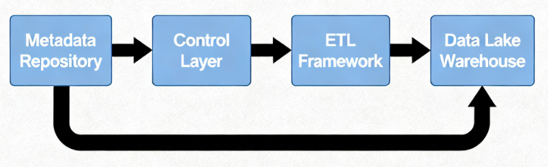
Metadata-Driven Pipeline Architecture
Metadata Repository → Control Layer → ETL Framework → Data Lake/Warehouse.
Step-by-Step Explanation:
Read Metadata – Pipeline reads config tables for job details.
Extract Data – Source systems (files, APIs, DBs) pulled dynamically.
Transform Data – Rules applied based on metadata definitions.
Load Data – Output stored in data warehouse or lake.
Log & Monitor – Results written back to audit tables.

Slide 6
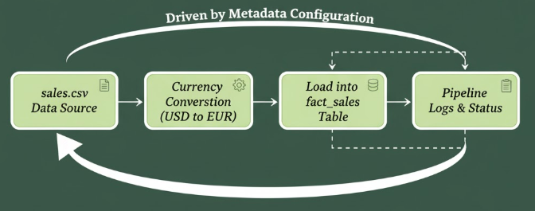
Example Workflow (ETL in Action)
Step Example:
Metadata defines:
Extract from sales.csv →
Apply currency conversion → Load into fact_sales.
Pipeline engine reads this config.
ETL script runs automatically for all active entries.
Logging captures run statistics.
Advantages of Metadata-Driven Approach
Simplifies onboarding of new data sources
Enables low-code/no-code data pipeline management
Reduces maintenance cost and dependency on developers
Challenges:
Designing flexible yet standardized metadata models.
Managing metadata versioning.
Maintaining performance when metadata grows large

Slide 7
Data Lineage and Cataloging Introduction

Slide 8
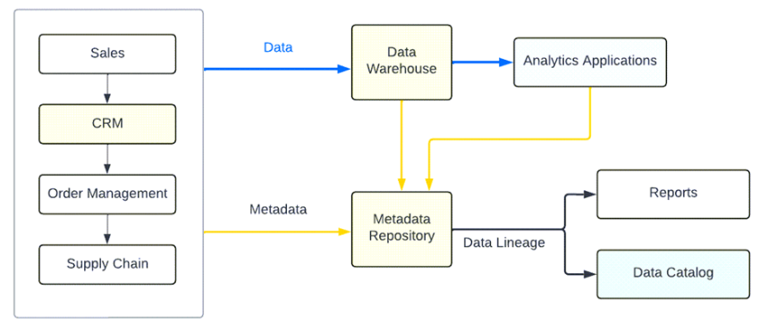
The Need for Data Lineage & Cataloging
Organizations rely on data for decision-making, but can they trust the data?
As data moves through multiple pipelines, transformations, and tools it becomes hard to track its origin, quality, and usage.
That’s where Data Lineage and Data Catalogs come in.
Key Question: Where did this data come from, how was it transformed, and who is using it?

Slide 9
What is Data Lineage And Its Types?
Data Lineage is the visual representation of data’s journey — from source to final destination — showing how data moves, transforms, and interacts across systems.
Explained Simply:
It’s like a map of your data’s life story:
Where it originated
How it changed
Where it’s used
Types of Data Lineage:
Type | Description | Example
End-to-End Lineage | Tracks data from source to destination | CSV → ETL → Snowflake → Tableau
Column-Level Lineage | Tracks transformations at field level | total_sales = price * quantity
Operational Lineage | Captures runtime events, job dependencies | Job1 → Job2 → Job3
Business Lineage | Maps data flow in business terms | “Customer Order” → “Sales Report”

Slide 10
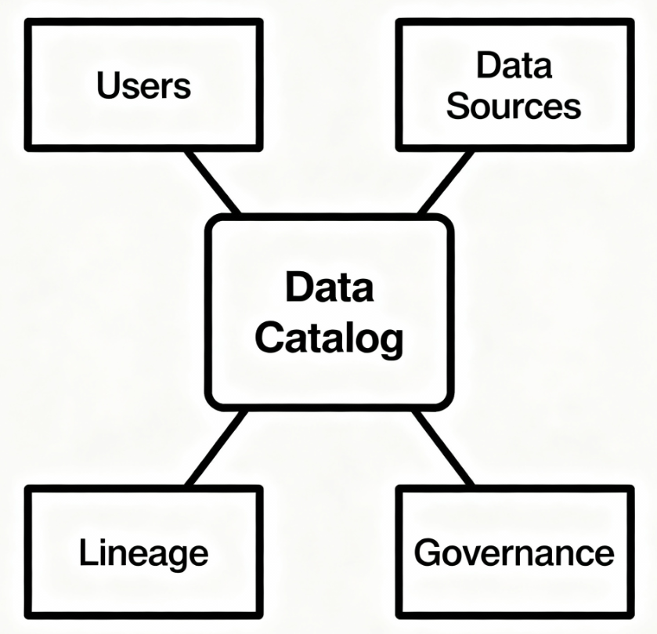
Data Catalog
A Data Catalog is a centralized inventory of all
organizational data assets enriched with metadata, lineage,
and usage information.
Purpose:
Helps users discover, understand, and trust data.
Functions like a “Google for your data.”
Catalog Metadata Includes:
Data source, schema, owner, tags, lineage, sensitivity, usage stats.
Key Components of a Data Catalog
Component | Description
Metadata Repository | Stores technical & business metadata
Data Lineage Engine | Maps and visualizes data flow
Business Glossary | Defines common business terms
Search & Discovery | Allows users to easily find datasets
Access & Governance Layer | Controls permissions, roles, and policies

Slide 11
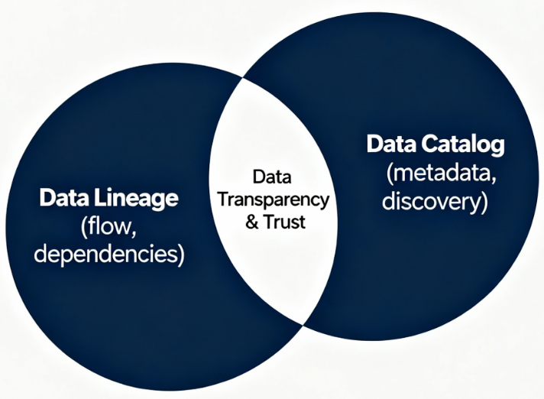
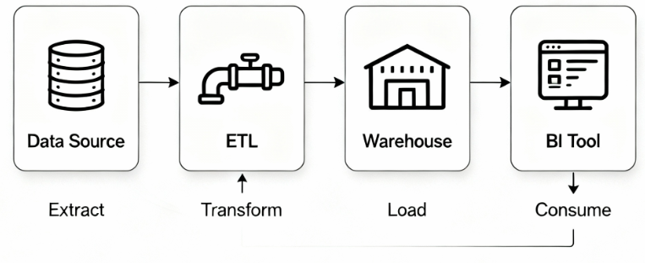
Data Lineage Working
Relationship Between Data Lineage and Data Catalog
Lineage = “How data moves.”
Catalog = “Where data lives and how to find it.” Together they provide data visibility + traceability + trust.
How Data Lineage Works (Process Flow)
Step-by-Step:
Extraction: Collect metadata from source systems, ETL tools, DBs.
Parsing & Mapping: Identify connections and dependencies.
Storage: Save lineage in metadata repository.
Visualization: Render interactive lineage graphs.
Monitoring: Continuously update as
Metadata pipelines evolve.

Slide 12
Benefits of Data Lineage & Data Catalog
Benefits of Implementing Data Lineage:
Transparency: Track data origins and changes.
Impact Analysis: See what’s affected if a column or job changes.
Compliance: Simplifies audits (GDPR, HIPAA).
Troubleshooting: Trace data errors back to their source.
Collaboration: Improves communication between data engineers, analysts, and governance teams.
Benefits of a Data Catalog:
Data Discovery: Find the right dataset faster.
Trust & Quality: Understand freshness, lineage, and owner.
Governance: Manage access control and compliance.
Productivity: Empower self-service analytics.
Central Knowledge Hub: Standardize business definitions.

Slide 13
Data Integrity / Data Quality basics

Slide 14
Data Integrity and Data Quality
Why Data Integrity and Data Quality Matter:
Data drives decisions — poor data leads to poor results.
Reliable data builds trust, improves efficiency, and supports compliance.
Inaccurate or inconsistent data can cause:
Wrong business insights
Customer dissatisfaction
Financial or operational errors
Data Integrity: Data Integrity ensures that data remains accurate, consistent, and reliable throughout its lifecycle.
Types of Data Integrity:
Physical Integrity – Protection from hardware failures, data loss, or corruption.
Logical Integrity – Ensures data follows business rules and relationships.
Example: If “Customer_ID” in Orders table doesn’t exist in Customer table → Integrity violation.

Slide 15
What is Data Quality
Data quality measures how well data serves its intended purpose. High-quality data is accurate, complete, consistent, timely, unique, and valid for its business use.
Dimensions of Data Quality:
Dimension | Description | Example
Accuracy | Data reflects real-world values correctly | Wrong age = inaccurate
Completeness | No missing important fields | Blank email field
Consistency | Same values across systems | Country name mismatch
Timeliness | Data is up-to-date | Old inventory data
Uniqueness | No duplicate records | Two entries for same ID
Validity | Matches defined format/rules | Invalid date or phone number

Slide 16
How to Maintain Data Quality and Integrity:
1. Data Governance:
Define clear data ownership and policies.
Set standards for naming, storage, and validation.
2. Data Profiling:
Analyze data patterns and detect anomalies regularly.
3. Data Validation:
Use rules and constraints (e.g., NOT NULL, CHECK, FOREIGN KEY).
4. Data Cleansing:
Correct or remove inaccurate and duplicate entries.
5. Monitoring & Auditing:
Track changes, maintain logs, and version control.
6. Automation:
Use ETL tools or scripts for automated validation and correction.

Slide 17
Data Governance (why business cares)

Slide 18
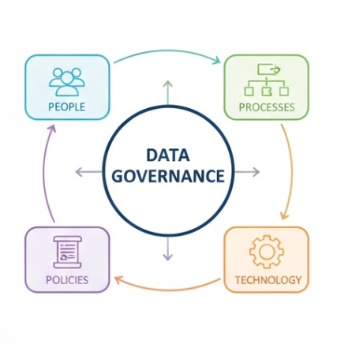
What is Data Governance?
Data Governance is the framework of rules, roles, policies, and processes that ensure data is accurate, secure, and used properly across an organization.
Key Focus Areas:
Defining ownership and accountability of data.
Ensuring data accuracy, consistency, and availability.
Aligning data usage with business goals and compliance.

Slide 19
Why Businesses Care About Data Governance
1. Decision-Making: Reliable data leads to confident, data-driven decisions.
2. Compliance & Risk Management: Prevents penalties by ensuring adherence to regulations (GDPR, HIPAA, etc.).
3. Trust & Reputation: Accurate data builds customer trust and brand integrity.
4. Operational Efficiency: Reduces duplication, rework, and confusion caused by poor data management.
5. Competitive Advantage: High-quality governed data allows faster insights and innovation.

Slide 20
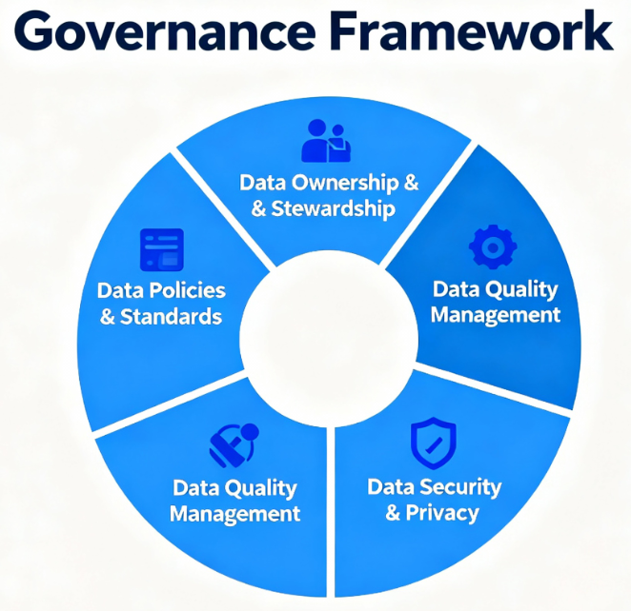
Core Components of Data Governance
1. Data Ownership & Stewardship: Defines who is responsible for data accuracy and maintenance.
2. Data Policies & Standards: Set rules for data usage, naming conventions, and access levels.
3. Data Quality Management: Processes for profiling, cleansing, validation, and monitoring.
4. Metadata Management: Captures data definitions, lineage, and relationships.
5. Data Security & Privacy: Controls access, encryption, and usage compliance.

Slide 21
Data Governance Framework
Typical Framework Includes:
Strategy: Define vision, objectives, and scope.
Organization: Assign roles (Data Owners, Stewards, Custodians).
Processes: Implement data lifecycle and quality checks.
Technology: Tools for metadata, cataloging, and monitoring.
Measurement: Track KPIs (data accuracy %, compliance rate).
Benefits of Effective Data Governance
Consistency: Unified definitions across systems.
Transparency: Clear understanding of where data comes from.
Compliance: Audit-ready and regulation aligned.
Efficiency: Reduces redundant data and manual corrections.
Value Creation: Turns data into a strategic asset for insights.

Slide 22
Master Data Management (MDM)

Slide 23
What is Master Data Management?
Master Data Management (MDM) is the process of creating and maintaining a single, consistent, and accurate version of key business data (called Master Data) across the entire organization.
Master Data Includes:
Ensure everyone uses the same, trusted version of key data for analytics and operations.
Category | Examples
Customer Data | Customer ID, Name, Address, Email, Phone
Product Data | Product ID, Description, Price, Category
Employee Data | Employee ID, Name, Department, Role
Supplier Data | Vendor ID, Name, Location, Contact Info
Location Data | Store ID, City, Country, Region

Slide 24
Why MDM is Important?
Data Consistency: Removes duplication and inconsistency across systems.
Decision Accuracy: Provides reliable, unified data for analysis and reporting.
Operational Efficiency: Reduces rework and confusion from mismatched data.
Compliance: Ensures regulatory data accuracy (GDPR, SOX, HIPAA, etc.).
Better Customer Experience: Gives a 360° view of customers across touchpoints.

Slide 25
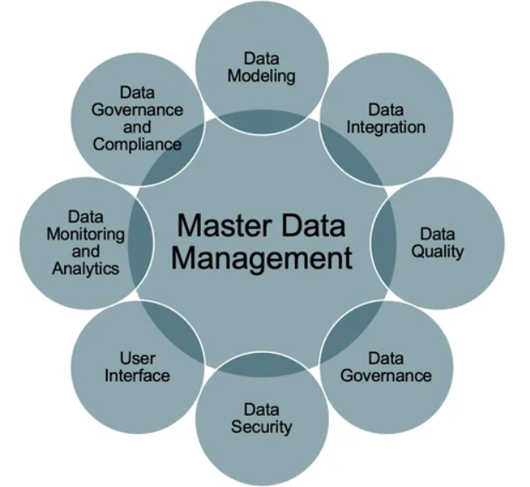
Key Components of MDM
Data Model:
Defines the structure and relationships of master data
(e.g., Product → Category → Supplier).
2. Data Governance: Policies and rules ensuring quality, ownership, and accountability.
3. Data Integration: Combines data from multiple systems into a central master record.
4. Data Quality Management: Processes for deduplication, standardization, and validation.
5. Metadata Management: Stores information about data meaning, lineage, and usage.
6. Workflow Management: Manages approvals, changes, and updates to master data..”

Slide 26
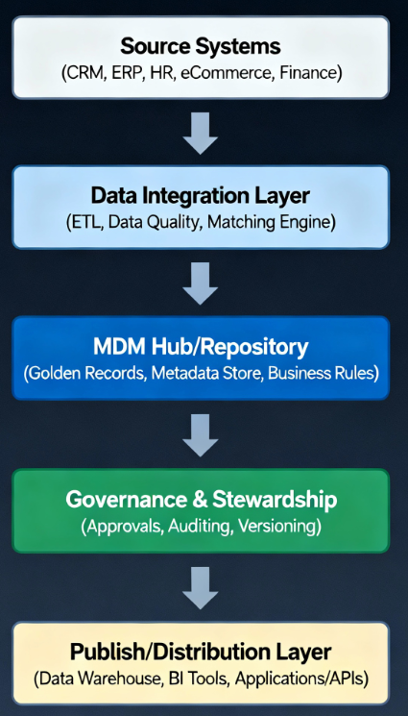
MDM Architecture Overview
Core Components:
Source Systems: ERP, CRM, HR, etc. — where master data originates.
Data Integration Layer: ETL/ELT processes extract and transform data.
MDM Hub: Central repository storing standardized, deduplicated “Golden Records.”
Data Quality Engine: Cleans, validates, and matches records using rules.
Governance Layer: Defines ownership, metadata, and approval workflows.
Distribution Layer: Publishes clean data to Data Warehouse, BI Tools, and Applications.
Common Architecture Styles:
Consolidation: Gathers data for analysis, sources unchanged.
Registry: Maintains references/links to master data only.
Coexistence: Synchronizes data between systems and hub.
Centralized: MDM hub is the single authoritative source.

Slide 27
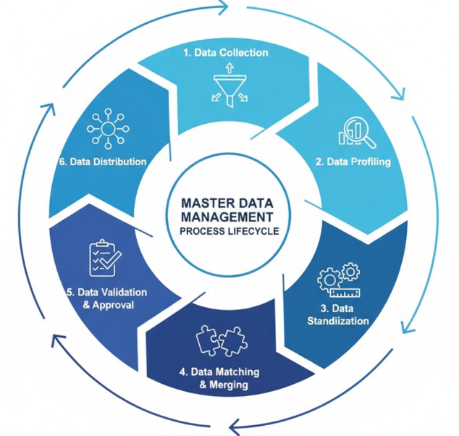
The MDM Process Lifecycle
Step 1: Data Collection – Gather data from all source systems. Step 2: Data Profiling – Analyze for duplicates and inconsistencies. Step 3: Data Standardization – Apply common formats and naming rules. Step 4: Data Matching & Merging – Identify and unify duplicate records. Step 5: Data Validation & Approval – Ensure data accuracy through governance. Step 6: Data Distribution – Publish trusted master data to all consuming systems.

Slide 28
Benefits And Challenges of Master Data Management
Benefits:
Single Source of Truth: Eliminates confusion from conflicting records.
Improved Analytics: Enables accurate dashboards and insights.
Enhanced Collaboration: All teams work from the same dataset.
Regulatory Compliance: Maintains audit-ready, accurate records.
Customer 360 View: Unifies customer data across departments.
Example: Without MDM → “John Smith” appears 5 times in CRM. With MDM → One unified “Golden Record” for John Smith.
Common Challenges:
Data silos and system integration complexity.
Poor data quality or missing governance.
Lack of executive sponsorship.
Cultural resistance to change.
Best Practices:
Start with a well-defined data domain (e.g., Customer).
Build strong data governance teams.
Use data quality tools for profiling and cleansing.
Continuously monitor and audit master data health.

Slide 29
Master Data Management vs. Data Warehousing

Slide 30
Introduction to MDM and DW
Master Data Management (MDM): A process and technology framework that creates a single, consistent view of core business entities such as Customers, Products, Suppliers, and Employees.
Focuses on data accuracy, consistency, and governance.
Ensures one “Golden Record” shared across systems.
Data Warehousing (DW): A centralized repository that stores historical and analytical data from multiple systems for reporting and analytics.
Focuses on data integration, analysis, and decision support.
Organizes data into facts and dimensions.

Slide 31
Core Purpose and Focus
Aspect | Master Data Management (MDM) | Data Warehousing (DW)
Purpose | To manage and maintain consistent master data across systems. | To integrate and analyze data for reporting and insights.
Focus | Data consistency and governance. | Data storage, aggregation, and analysis.
Primary Users | Data stewards, data governance teams. | Business analysts, data scientists, management.
Example Use | Ensure one customer record across CRM & ERP. | Analyze sales trends by region or time.

Slide 32
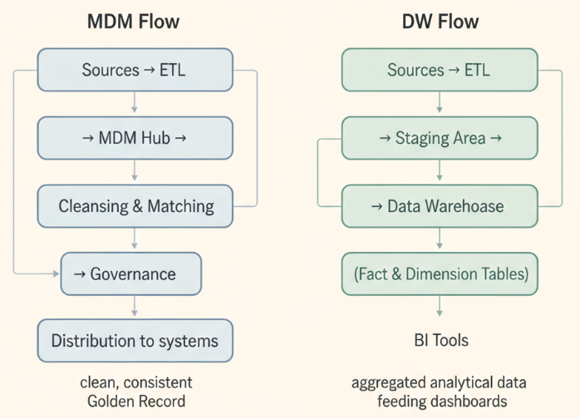
Architecture Overview
MDM Architecture Highlights:
Sources → ETL → MDM Hub → Cleansing & Matching → Governance → Distribution to systems.
Emphasizes data validation, deduplication, and version control.
DW Architecture Highlights:
Sources → ETL → Staging Area → Data Warehouse (Fact & Dimension Tables) → BI Tools.
Emphasizes data aggregation, transformation, and reporting.

Slide 33
Key Differences
Category | MDM | Data Warehouse
Data Type | Master data (Customers, Products, Employees) | Transactional & historical data (Sales, Orders, KPIs)
Data Volume | Smaller, highly curated | Large, analytical datasets
Update Frequency | Near real-time (for sync) | Batch or scheduled loads
Ownership | Business + Data Governance teams | IT / Analytics teams
Output | Golden Master Data | Analytical Reports & Dashboards

Slide 34
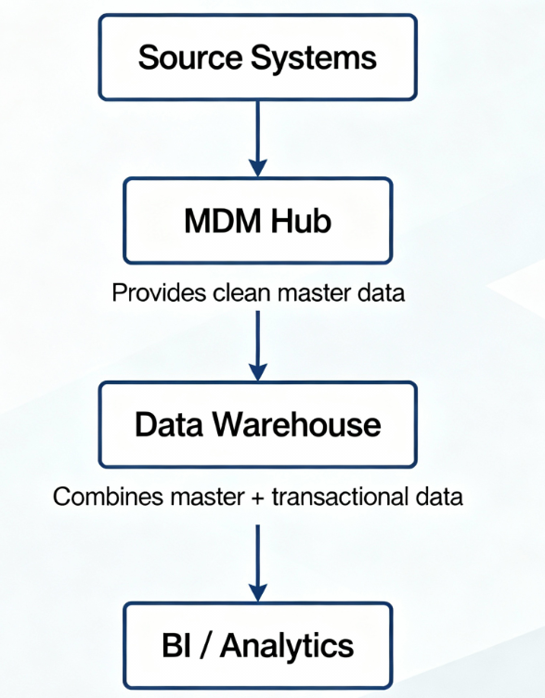
How MDM and DW Work Together
MDM feeds DW with clean, consistent master data.
Example: Customer IDs, product categories, or location hierarchies standardized in MDM → loaded into DW for analytics.
Ensures analytics are based on trusted and uniform data definitions.
Combined Value:
MDM → “Truth of data”
DW → “Truth in numbers”

